Slide 1


KuaiShou（1024.HK）：
A Tumultuous Fate
Qin Shuyan | Dong Xingchen | Wang Shuning | Li Boyang | Li Zexuan | Li Yuanzhe
April 2023
Notes:
大家好，我们是Group 6，我们想要展示的公司是快手。我们的小组成员有Qin Shuyan | Dong Xingchen | Wang Shuning | Li Boyang | Li Zexuan | Li Yuanzhe。现在将由我为大家展示第一部分。
Hello everyone, we are Group 6, and the company we are focusing on is 快手. Our team members are: Qin Shuyan | Dong Xingchen | Wang Shuning | Li Boyang | Li Zexuan | Li Yuanzhe. Now I will introduce the first part, which is Company Profile.

Slide 2
Basic Information
Company Profile
Industry Analysis
Business Analysis
Revenue Forecast
Firm Valuation
1
Development Path
2011: predecessor - "Kuaishou GIF"
2013: transformed into a short video social platform
2014: officially changed its name to “Kuaishou” and became a community for “老铁们" to record and share.
2016: became the leading platform in this industry.
2017 and 2018: commercialized the advertising and e-commerce segments, forming a basic business pattern.
Before 2018
2019: Launched the Kuaishou Extreme Edition（快手极速版）
2020: ushers in Jay Chou; launches up and down single-column information flow
2021: Successfully listed on the Hong Kong Stock Exchange.
Currently: the leader in short videos; three major businesses of advertising, live broadcast, and e-commerce continue to be optimized and upgraded.
Since 2019
Notes:
第一部分是Development Path。可以概括为两个阶段，before 2018 and since 2019。
The first part is the Development Path. It can be summarized into two stages, before 2018 and since 2019.
我们先看一下2018年以前它做了什么：
Let’s first take a look at what it had done before 2018:
1）2018年及以前： 2011年3月，程一笑先生创立公司前身——“快手GIF”图像制作工具。2013年，在宿华先生的加入和带领下，公司成功转型为短视频社交平台，2014年正式更名为“快手”，成为“老铁”们记录和分享的社区。2016年，快手根据当时的平台生态自然延伸出直播打赏业务，逐渐成为该行业的领先平台。2017年和2018年，公司相继对广告和电商板块进行商业化变现，形成基本业务格局。
The predecessor - "Kuaishou GIF" was founded in 2011.
It transformed into a short video social platform in 2013.
From then on, it became a community for “老铁们" to record and share.
In 2017 and 2018, it formed a basic business pattern by commercializing the advertising and e-commerce segments.
2）2018年以后：
After 2018,
随着行业竞争加剧，快手加速业务扩张，2019年推出快手极速版，打响K3战役和春晚战役，流量迅速增长；2020年6月，平台迎来乐坛顶流周杰伦，加大明星引入；同年9月，8.0版本正式上线，推出上下滑单列信息流，强化平台运营。2021年初，公司于港交所成功上市，并于21Q3进行组织架构调整，进一步清晰业务布局。目前，快手已成为短视频龙头，广告、直播、电商三大业务持续优化升级。
it launched the Kuaishou Extreme Edition（快手极速版）, the number of users grew rapidly thereafter.
In 2020, it launches up and down single-column information flow and finally, got listed on the Hong Kong Stock Exchange in 2021
Currently it has become the leader in short videos and its 3 major businesses continue to be optimized and upgraded as we can see from these 2 charts on the right (which shows 快手’s Operating Income and Revenue Composition from 2018 to 2022).

Slide 3
Basic Information
Company Profile
Industry Analysis
Business Analysis
Revenue Forecast
Firm Valuation
1
Issuing Background
Review of Stock Price
2
Items | Information
Method of IPO | Global Sale
Date of IPO | 2021-2-5
Size of IPO | The issuance size was 365,218,600 shares, the price per share was 115 HKD, and a total of 42.00014 billion HKD was raised.
Name of the IPO Firm | Kuaishou Technology
Name of the Underwriter | Huaxing Securities (Hong Kong) Co.,Ltd. Morgan Stanley Asia Co.,Ltd.
IPO First-day Return | +160.87%
Cornerstone or Strategic Investors | The Capital Group Funds Aranda Investments Pte. Ltd. GIC Private Limited Invesco Ltd. 富达国际 BlackRock, Inc. Canada Pension Plan Investment Board Sunny Festive Limited 摩根士丹利亚洲有限公司 and Morgan Stanley Investment Management Inc. Abu Dhabi Investment Authority
Notes:
Here comes to 快手’s Issuing Background and Stock Price since its issuance. It was listed on Feb 5 2021 and the IPO First-day Return is 160.87%. Now let’s welcome 博阳 for next part, Industry Analysis.

Slide 4













Industry Analysis
Company Profile
Industry Analysis
Business Analysis
Revenue Forecast
Firm Valuation
1
Content APP Map: Short Video Has Short Time but Strong Expression
Length
Real-time post
Info / note
Books
Image-text
Short video
Middle video
Long video
Video
Content expression
Easy to Embed Ads.
High frequency social platform
&
Abundant commercializing opportunities
Short length
Short video
Easy to spread
Both visual & auditory
Immersive information flow
Notes:
From here we can see that live streaming business is the largest part of the company，and it is also the biggest variable of the company's future development

Slide 5

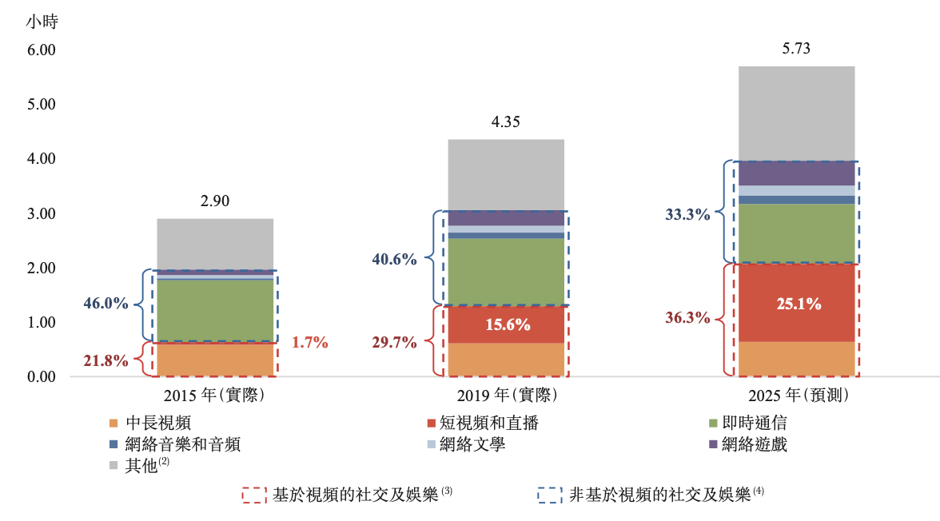


Industry Analysis
Company Profile
Industry Analysis
Business Analysis
Revenue Forecast
Firm Valuation
2
Short video market in China is growing at a high speed
Driving factors
The number of short video users and their usage time are growing rapidly
Popularization of mobile Internet
Development of communication technology
CAGR=81.7%
Growing need for social expression
IPO
Source: Prospectus of Kuaishou, 2021
Notes:
From here we can see that live streaming business is the largest part of the company，and it is also the biggest variable of the company's future development

Slide 6
Industry Analysis
Company Profile
Industry Analysis
Business Analysis
Revenue Forecast
Firm Valuation
2
Competition Pattern: Duopoly between Douyin & Kuaishou
Short video platforms in China have formed duopoly pattern between Douyin and Kuaishou (in Jan. 2021) but there is a big tail space. Kuaishou lags behind Douyin in terms of user scale.
Launch time
Sep. 2016
Mar. 2011
Compared with Douyin, Kuaishou has an advantage in markets in lower-tier cities. As for age distribution, Kuashou‘s users under 15 and over 51 account for a higher proportion than Douyin.
Source: Public data in Dec. 2020 (just before IPO)
Notes:
From here we can see that live streaming business is the largest part of the company，and it is also the biggest variable of the company's future development

Slide 7

Corporate business: live streaming
Company Profile
Industry Analysis
Business Analysis
Revenue Forecast
Firm Valuation
live streaming is one of the main content consumption methods of users on Kuaishou platform.
The proportion of users watching live streaming on Kuaishou reaches 87.9% and presents a steady trend of improvement. The pay rate for live streaming reached 12%.
The revenue of Kuaishou's live-streaming mainly comes from viewers' virtual gift gratuity to streamers,and Kuaishou earns income from the percentage of virtual gift gratuity.
However, due to the government regulation, the rapid growth of live streaming has stopped.
Kuaishou livestreaming mode
Revenue from livestreaming tips becomes stable
Broadcast room
Use real money to exchange virtual gift
Send gifts to streamer
Source: Prospectus of Kuaishou, 2021

Slide 8
Corporate business: advertisement
Company Profile
Industry Analysis
Business Analysis
Revenue Forecast
Firm Valuation
The proportion of Internet advertising market is increasing year by year, and short video accounts for a rapidly increasing share of Internet advertising market.
The percentage of the Internet advertising market
Internet advertising market composition
advertising market size (100 million yuan)
e-commerce
short video
online video
Internet advertising market size
social network
pan-information
others
Internet advertising propotion
Inner cycle advertising: mainly comes from interior merchants and experts. The purpose is to improve the broadcast room flow, increase the shop visits and order turnover.
Innner cycle advertising revenue =
GMV (Gross Merchandise Volume) * Advertising fee rate

Slide 9





Corporate business: advertisement
Company Profile
Industry Analysis
Business Analysis
Revenue Forecast
Firm Valuation
Outer cycle advertising: mainly external merchants needs, including financial service providers, network service providers, game providers,etcs.
Revenue from outer cycle advertising =
DAU ( daily active users) +
short video viewing time per capita +
Feed per minute +
Ad load+
eCPM(effective cost per mille)
open screen advertising
double information flow
single information flow
video page card
e-commerce page card
Source: Prospectus of Kuaishou, 2021

Slide 10
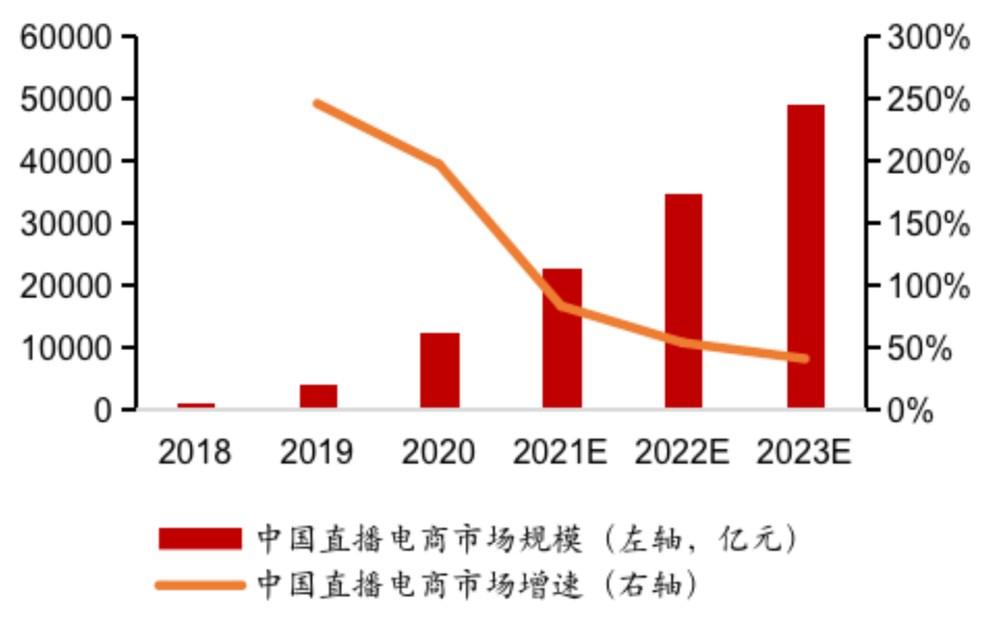
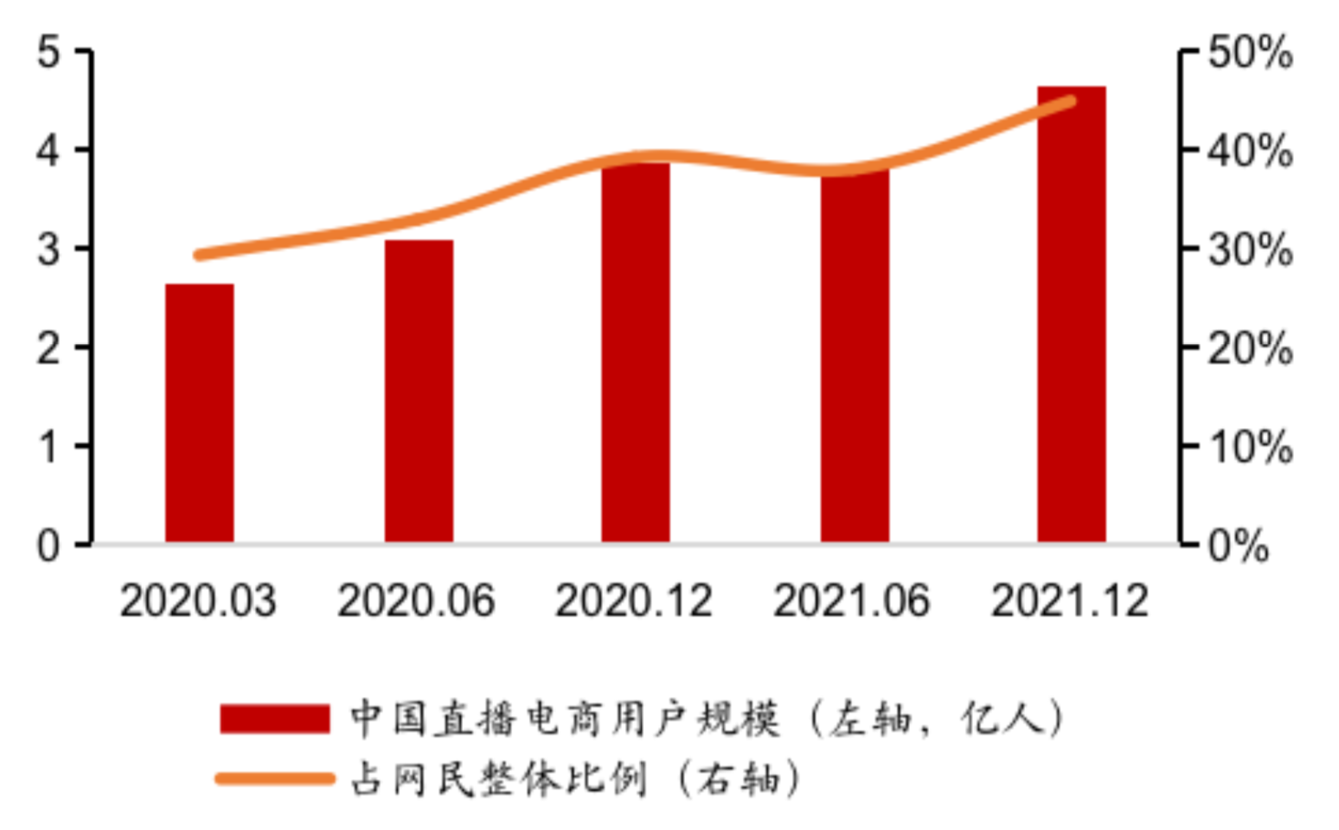
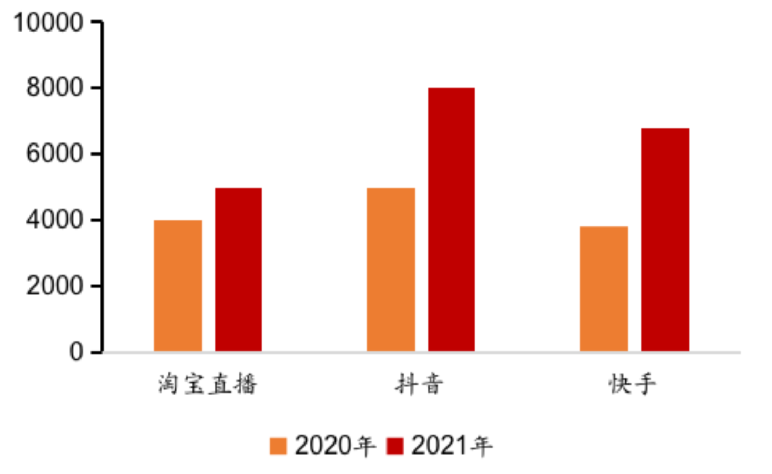

Corporate Business: E-commerce
Company Profile
Industry Analysis
Business Analysis
Revenue Forecast
Firm Valuation
1
Size of e-commerce market
Market size of live streaming e-commerce in China
Scale of live streaming users of e-commerce
Three live streaming e-commerce platforms GMV(100 million yuan)
Market size(100m yuan)
Market growth rate
Scale of live streaming users (100 million)
Proportion for the overall Internet users
Taobao Douyin KuaiShou
2020
2021
Source: Public data in iResearch, Dec. 2023
Type | representative | characteristic | transformation path
Traditional e-commerce | Taobao, Jingdong, Pinduoduo | Abundant resources of goods and merchants, mature e-commerce services and consumer rights protection system. | Main path: consumers search for target product
Content e-commerce | Douyin, Kuaishou, Bilibili | This kind of platform comes with its own flow and turn the flow to profit through e-commerce. | Main path: Consumers do not have a clear shopping purpose, guided by the platform information for consumption
Social e-commerce | Wechat, Weibo, Red | Convert flow aggregation into business value and have strong social advantages.
Notes:
直播电商从 2016 年萌芽，在近5年内开始爆发式增长，当前直播已经成为电商市场常态化的营销方式，由于直播电商可以提供更加生动且富有深度的商品展示， 在购物过程中具备更强的互动性、引导性 和专业性，深受用户喜爱，从三大直播电商平台的交易额来看，快手和抖音两大短视频平台的成长性高于传统电商平台，主要是受益于短视频平台的流量优势和沉浸式体验的生态调性，其中，快手直播电商GMV位列行业第二，领先地位明显。

Slide 11





Corporate Business: E-commerce
Company Profile
Industry Analysis
Business Analysis
Revenue Forecast
Firm Valuation
2
KuaiShou live streaming e-commerce
Kuaishou‘s live streaming e-commerce is essentially a continuation of its live streaming ecology, mainly includes two categories :
1. Live broadcast: users enter the live broadcast room through various entrances, watch the live broadcast and place orders;
2. Information flow: Kuaishou recommends information flow advertisements on various subdivided pages, and users can click on the product details page and directly transact within the platform
Producer
Anchor
KuaiShou
Consumer
Content platform E-commerce oriented
Content
Platform
E-commerce
Platform
E-commerce platforms content oriented
Notes:
在信息流形式中，创作者需要产出用户喜爱的内容， 而直播形式可以为用户提供通向内容描绘场景的阶梯，每一帧画面都可以是货架，出现的每一个物件和场景都可以是商品，具备更强的互动性、趣味性和专业性。本质上，传统电商和 二类电商只是改变了商品的详情页形式，前者的优势在于成熟的推荐算法可以高效匹配需 求，后者的优势在于内容展现有广阔的施展空间，并通过优质内容提高转化率，短视频平台 的 电商业务具备更好的前景和更大机会。
直播电商从 2016 年萌芽，在近5年内开始爆发式增长，当前直播已经成为电商市场常态化的营销方式，由于直播电商可以提供更加生动且富有深度的商品展示， 在购物过程中具备更强的互动性、引导性 和专业性，深受用户喜爱，从三大直播电商平台的交易额来看，快手和抖音两大短视频平台的成长性高于传统电商平台，主要是受益于短视频平台的流量优势和沉浸式体验的生态调性，其中，快手直播电商GMV位列行业第二，领先地位明显。

Slide 12
Corporate Business: E-commerce
Company Profile
Industry Analysis
Business Analysis
Revenue Forecast
Firm Valuation
3
GMV calculation
Traditional e-commerce logic: platform as the core, flow-driven：
【GMV = UV * Conversion rate * Customer Unit Price】
KuaiShou e-commerce logic: user-centered, content-driven:
【GMV = UV * Content consumption hours * Unit market order conversion rate * Customer Unit Price * Repurchase frequency 】
Appeal
Incentive to buy
Attract attention
Trust
Purchase
Retention
Purchase conversion
Reasons why users use live streaming e-commerce
The current top five reasons for users to use live e-commerce, three of them are related to price concessions
The high interaction and repurchase rate of users will help KuaiShou dig deeper into the value of users
Notes:
Traditional e-commerce logic: platform as the core, flow-driven：
KuaiShou e-commerce logic: user-centered, content-driven:

Slide 13
Revenue Forecast
Company Profile
Industry Analysis
Business Analysis
Revenue Forecast
Firm Valuation
1
Revenue Forecasting Framework
Livestreaming Revenue
MAU* Penetration rate of live streaming payment* ARPU
Advertisement Revenue
External circulation advertising revenue
Operating Revenue
Internal circulation advertising revenue
Net Profit
E-commerce Revenue
GMV* Take Rate（%）
Other Revenue
Mainly local takeout, gradually reduce
Revenue sharing
Live-streaming Revenue* take rate（%） +Advertisement Revenue* take rate（%）
Bandwidth cost
MAU* Bandwidth cost per month
Cost and Expense
Marketing expenses
Gradually reduce
Notes:
As an asset-light Internet company, the earnings forecast is the most critical part.
Starting from the business structure of the company, we split the earnings forecast according to the business, and calculated it separately from the perspective of revenue and cost.
As mentioned earlier, the company's business can be divided into four parts,
In the live business part, mainly according to MAU and ARPU split;
In the advertising business part, divided into inner cycle and outer cycle advertising;
In the e-commerce business section, we focus on GMV and take rate
On the cost side, we focus on revenue sharing cost; bandwidth cost and marketing expensing

Slide 14
Revenue Forecast
Company Profile
Industry Analysis
Business Analysis
Revenue Forecast
Firm Valuation
2
Evidence of prediction
ARPU per month
Ad Revenue per user per day
Viewing time per user
3
Key Assumptions
ARPU and live streaming penetration rate is going to decrease steadily
Ad Revenue per user per day is going to increase but the increasing rate is going to slow down
Viewing time per user per day is going to increase but the increasing rate is going to slow down
Other column are predicted according to historical data and industry average
Source: wind, KuaiShou company filings
Notes:
Our earnings forecast is based on the company's historical data and industry averages
As is shown in the figure, the company's ARPU and pay rate tend to decline slowly after reaching the peak in 2020, but the viewing time and payment scale show an increasing trend, especially the per capita viewing time reaches 112 minutes in 2022.
However, this growth trend will show a marginal decreasing trend due to market saturation and the upper limit of mobile phone market
So， our key assumptions are ……
Detailed data can be viewed in our manuscript

Slide 15
Revenue Forecast
Company Profile
Industry Analysis
Business Analysis
Revenue Forecast
Firm Valuation
3
Internet users and penetration rate of Kuaishou users Forecast
Users Forecast | 2019A | 2020A | 2021A | 2022E | 2023E | 2024E | 2025E | 2026E
Total population of China (billion) | 14.08 | 14.11 | 14.12 | 14.12 | 14.12 | 14.12 | 14.12 | 14.12
Internet penetration (%) | 80.97% | 82.21% | 82.86% | 83.36% | 83.76% | 84.06% | 84.36% | 84.66%
Number of Internet users | 11.40 | 11.60 | 11.70 | 11.77 | 11.83 | 11.87 | 11.91 | 11.95
Short video penetration rate (%) | 72.81% | 75.26% | 79.83% | 81.83% | 83.33% | 84.33% | 85.33% | 86.33%
Short video Users (billion) | 8.30 | 8.73 | 9.34 | 9.63 | 9.86 | 10.01 | 10.16 | 10.32
Market share (%) | 39.76% | 55.10% | 58.24% | 62.24% | 63.24% | 63.74% | 64.24% | 64.74%
MAU of KUAISHOU | 3.30 | 4.81 | 5.44 | 6.00 | 6.23 | 6.38 | 6.53 | 6.68
DAU/MAU（%） | 53.33% | 55.09% | 56.62% | 59.62% | 60.62% | 61.12% | 61.62% | 62.12%
DAU of KUAISHOU | 1.76 | 2.65 | 3.08 | 3.57 | 3.78 | 3.90 | 4.02 | 4.15
4
Revenue Forecast——Splitting Business into 4 parts
Advertising business forecast | 2019A | 2020A | 2021A | 2022E | 2023E | 2024E | 2025E | 2026E
Outer-cycle advertising
DAU（billion） | 1.76 | 2.65 | 3.08 | 3.57 | 3.78 | 3.90 | 4.02 | 4.15
Per capita short video viewing time (min) | 52.01 | 60.92 | 77.38 | 87.38 | 89.38 | 90.38 | 91.38 | 92.38
Feeds viewed per minute (num/min) | 2.46 | 2.46 | 2.46 | 2.46 | 2.46 | 2.46 | 2.46 | 2.46
ad load（%） | 5.40% | 6.00% | 6.80% | 7.00% | 7.40% | 7.60% | 7.80% | 8.00%
eCPM(yuan/thousand times) | 15.21 | 17.84 | 19.65 | 15.65 | 19.65 | 21.65 | 22.65 | 23.65
External circulation advertising (billion) | 67.51 | 155.17 | 285.95 | 307.21 | 440.93 | 520.71 | 583.26 | 651.37
Inner loop advertising
GMV（billion yuan） | 596 | 3812 | 6800 | 8765 | 10435 | 12003 | 13738 | 15652
Advertising rate (%) | 1.12% | 1.66% | 2.07% | 2.17% | 2.27% | 2.37% | 2.47% | 2.57%
Internal circulation advertising revenue (billion yuan) | 6.68 | 63.38 | 140.70 | 190.13 | 236.78 | 284.36 | 339.20 | 402.10
Overall advertising
Total advertising revenue (billion yuan) | 74.2 | 218.5 | 426.7 | 497.34 | 677.71 | 805.07 | 922.46 | 1053.47
Notes:
As for revenue forecasting process, we start from the user scale of Kuaishou， which MAU is estimated to reach 6.68billion at 2026
And then we estimate the revenue according to splitting business----which are advertising business

Slide 16
Revenue Forecast
Company Profile
Industry Analysis
Business Analysis
Revenue Forecast
Firm Valuation
4
（continued）Revenue Forecast——Splitting Business into 4 parts
Live streaming business forecast | 2019A | 2020A | 2021A | 2022E | 2023E | 2024E | 2025E | 2026E
DAU（billion） | 1.76 | 2.65 | 3.08 | 3.57 | 3.78 | 3.90 | 4.02 | 4.15
Live streaming payment penetration rate (%) | 27.84% | 21.89% | 15.58% | 16.08% | 16.48% | 16.78% | 16.98% | 17.08%
Paid users of live streaming (billion) | 0.49 | 0.58 | 0.48 | 0.57 | 0.62 | 0.65 | 0.68 | 0.71
ARRPU per month (yuan/person/month) | 53.47 | 47.71 | 53.81 | 49.81 | 47.81 | 46.81 | 45.81 | 44.81
Revenue of livestreaming business (billion) | 314.42 | 332.09 | 309.95 | 343.63 | 357.33 | 367.66 | 375.67 | 381.29
E-commerce business forecast | 2019A | 2020A | 2021A | 2022E | 2023E | 2024E | 2025E | 2026E
MAU（billion） | 3.30 | 4.81 | 5.44 | 6.00 | 6.23 | 6.38 | 6.53 | 6.68
E-commerce penetration rate (%) |  | 21.00% | 34.38% | 36.38% | 37.88% | 38.88% | 39.88% | 40.88%
Annual Active Buyer (billion) |  | 1.01 | 1.87 | 2.18 | 2.36 | 2.48 | 2.60 | 2.73
Purchase frequency (times/year) |  | 35 | 47 | 50 | 53 | 56 | 59 | 62
Customer price (yuan/time) |  | 109 | 78 | 81 | 84 | 87 | 90 | 93
GMV（billion yuan） | 596 | 3812 | 6800 | 8765 | 10435 | 12003 | 13738 | 15652
take rate（%） | 0.44% | 0.97% | 1.09% | 1.29% | 1.49% | 1.69% | 1.89% | 2.09%
E-commerce revenue (billion yuan) | 2.60 | 37.12 | 74.21 | 113.18 | 155.61 | 203.00 | 259.81 | 327.31
Other business forecast | 2019A | 2020A | 2021A | 2022E | 2023E | 2024E | 2025E | 2026E
MAU（billion） | 3.30 | 4.81 | 5.44 | 6.00 | 6.23 | 6.38 | 6.53 | 6.68
Local income per user (yuan/person) |  |  |  | 0.59 | 4.35 | 8.23 | 10.54 | 13.11
Revenue per user of e-commerce (yuan/person) | 2.81 | 20.89 | 39.51 | 50.59 | 62.95 | 76.38 | 91.73 | 109.17
Percentage of revenue per user of e-commerce/Local Living (%) |  |  |  | 20.83% | 20.83% | 20.83% | 20.83% | 20.83%
Other revenue (billion Yuan) |  |  |  | 3.51 | 27.12 | 52.50 | 68.80 | 87.61
Notes:
From here we can see that live streaming business is the largest part of the company，and it is also the biggest variable of the company's future development

Slide 17
Revenue Forecast
Company Profile
Industry Analysis
Business Analysis
Revenue Forecast
Firm Valuation
Revenue Forecast (billion Yuan) | 2019A | 2020A | 2021A | 2022E | 2023E | 2024E | 2025E | 2026E
Total Revenue | 391.20 | 587.76 | 810.81 | 957.66 | 1217.78 | 1428.23 | 1626.75 | 1849.68
Live streaming revenue | 314.42 | 332.09 | 309.95 | 343.63 | 357.33 | 367.66 | 375.67 | 381.29
Advertising revenue | 74.19 | 218.55 | 426.65 | 497.34 | 677.71 | 805.07 | 922.46 | 1053.47
E-commerce business revenue | 2.60 | 37.12 | 74.21 | 113.18 | 155.61 | 203.00 | 259.81 | 327.31
Other revenue |  |  |  | 3.51 | 27.12 | 52.50 | 68.80 | 87.61
Total operating cost | 250.17 | 349.59 | 470.50 | 510.95 | 580.02 | 632.77 | 671.33 | 711.85
Revenue sharing costs and related taxes | 181.49 | 205.19 | 247.92 | 293.90 | 325.80 | 345.28 | 359.81 | 371.94
Share ratio of livestreaming revenue (%) |  |  | 60.00% | 60.00% | 60.00% | 60.00% | 60.00% | 60.00%
Proportion of revenue sharing between e-commerce and advertising (%) |  |  | 12.37% | 14.37% | 13.37% | 12.37% | 11.37% | 10.37%
% of revenue | 46.39% | 34.91% | 30.58% | 30.69% | 26.75% | 24.18% | 22.12% | 20.11%
Broadband fees and server hosting costs | 26.51 | 57.35 | 76.38 | 66.20 | 68.20 | 69.17 | 70.14 | 71.10
Bandwidth cost per MAU | 8.03 | 11.92 | 14.04 | 11.04 | 10.94 | 10.84 | 10.74 | 10.64
% of revenue | 6.78% | 9.76% | 9.42% | 6.91% | 5.60% | 4.84% | 4.31% | 3.84%
Depreciation of use right assets and amortization of intangible assets | 19.91 | 45.74 | 62.46 | 59.41 | 74.33 | 85.74 | 96.03 | 107.34
% of revenue | 5.09% | 7.78% | 7.70% | 6.20% | 6.10% | 6.00% | 5.90% | 5.80%
Employee benefit cost |  | 17.12 | 34.51 | 39.80 | 49.40 | 56.50 | 62.73 | 69.48
% of revenue | 0.00% | 2.91% | 4.26% | 4.16% | 4.06% | 3.96% | 3.86% | 3.76%
Channel commission | 6.42 | 10.04 | 16.02 | 17.96 | 21.63 | 23.93 | 25.63 | 27.30
% of revenue/processing rate (%) | 1.64% | 1.71% | 1.98% | 1.88% | 1.78% | 1.68% | 1.58% | 1.48%
Other operation cost | 15.84 | 14.15 | 33.20 | 33.68 | 40.67 | 52.14 | 56.97 | 64.69
% of revenue | 4.05% | 2.41% | 4.09% | 3.52% | 3.34% | 3.65% | 3.50% | 3.50%
Gross Profit | 141.03 | 238.17 | 340.32 | 446.71 | 637.76 | 795.46 | 955.43 | 1137.82
Marketing expenses | -98.65 | -266.15 | -441.76 | -387.70 | -432.11 | -435.37 | -414.55 | -378.88
% of revenue | -25.22% | -45.28% | -54.48% | -40.48% | -35.48% | -30.48% | -25.48% | -20.48%
Administrative expenses | -8.65 | -16.77 | -34.00 | -53.57 | -65.68 | -74.17 | -81.23 | -88.66
% of revenue | -2.21% | -2.85% | -4.19% | -5.59% | -5.39% | -5.19% | -4.99% | -4.79%
Research and development expenses | -29.44 | -65.48 | -149.56 | -147.92 | -188.09 | -220.60 | -251.26 | -285.70
% of revenue | -7.53% | -11.14% | -18.45% | -15.45% | -15.45% | -15.45% | -15.45% | -15.45%
Other income | 2.92 | 5.27 | 10.26 | 9.28 | 12.71 | 15.61 | 16.84 | 19.56
% of revenue | 0.75% | 0.90% | 1.27% | 0.97% | 1.04% | 1.09% | 1.04% | 1.06%
Other gains/losses | 1.76 | -0.32 | -2.25 | 0.00 | 0.00 | 0.00 | 0.00 | 0.00
Operating Revenue | 8.97 | -105.28 | -276.99 | -133.18 | -35.41 | 80.92 | 225.22 | 404.15
Financial expenses | -0.11 | -0.35 | -0.39 | -0.43 | -0.62 | -0.68 | -0.78 | -0.91
% of revenue | -0.03% | -0.06% | -0.05% | -0.05% | -0.05% | -0.05% | -0.05% | -0.05%
Convertible redeemable preferred stock fair value change | -199.43 | -1068.46 | -512.76 | 0.00 | 0.00 | 0.00 | 0.00 | 0.00
Change in fair value of investment | 0.00 | 0.00 | -0.87 | 0.00 | 0.00 | 0.00 | 0.00 | 0.00
Pre-tax profit/total loss | -190.57 | -1174.09 | -791.00 | -133.61 | -36.03 | 80.24 | 224.44 | 403.24
Income tax | 3.86 | -5.66 | -10.25 | -13.36 | -4.68 | 10.43 | 29.18 | 52.42
Income tax rate % | -2.03% | 0.48% | 1.30% | 10.00% | 13.00% | 13.00% | 13.00% | 13.00%
Net profit/loss | -194.43 | -1168.44 | -780.75 | -120.25 | -31.35 | 69.81 | 195.27 | 350.82
Notes:
Finally, we reach to the conclusion that Kuaishou will return to positive net profit for the first time in 2024.
We include a more detailed results in our DCF model. So let’s welcome Xingchen for the next part.

Slide 18
P/S & P/GMV Valuation Method
Company Profile
Industry Analysis
Business Analysis
Revenue Forecast
Firm Valuation
Advertising Business
Comparable Company of Advertising Business | Code | Revenue （2022, in Billion） | Market Value （2022, in Billion） | 2022 P/S
谷歌 | GOOGL.O | 16,349.37 | 88,161.62 | 5.39
Meta | META.O | 8,093.21 | 26,963.47 | 3.33
微博 | WB.O | 129.79 | 411.39 | 3.17
腾讯控股 | 00700.HK | 5,610.51 | 31957.44 | 5.7
Whole Company
Comparable Company of Advertising Business | 2022 P/S | Revenue （2022, in Billion） | Division Valuation (in Billion)
 | 3 | 497.34 | 1492.03
Comparable Company of Live Streaming Business | 2022 P/S | Revenue （2022, in Billion） | Division Valuation (in Billion)
 | 1 | 343.63 | 343.63
Comparable Company of E-commerce Business | 2022 P/GMV | Revenue （2022, in Billion） | Division Valuation (in Billion)
 | 0.2 | 8766.39 | 1753.08
Whole Company | Total Valuation (in Billion) | Implied stock price | Current share price
 | 3588.73 | 83.37 | 54.05
Live Streaming Business
Comparable Company of Live Streaming Business | Code | Revenue （2022, in Billion） | Market Value （2022, in Billion） | 2022 P/S
斗鱼 | DOUYU.O | 71.87 | 41.77 | 0.58
虎牙 | HUYA.N | 93.7 | 100.33 | 1.07
陌陌 | MOMO.O | 126.94 | 145.32 | 1.14
腾讯音乐 | TME.N | 282.36 | 1,009.68 | 3.58
bilibili | BILI.O | 221.67 | 722.59 | 3.26
E-commerce Business
Comparable Company of E-commerce Business | Code | Revenue （2022, in Trillion） | Market Value （2022, in Billion） | 2022 P/GMV
拼多多 | PDD.O | 33,243 | 8,743.98 | 0.26
京东 | JD.O | 36,613 | 6357.30 | 0.17
阿里巴巴 | BABA.N | 79,176 | 20,058.86 | 0.25
Notes:
In the part of relative valuation method, we used PS valuation method and P/GMV valuation method, mainly considering that the company is in the growth stage and has not yet realized profit.
We divided the company‘s business into three parts and selected several comparable companies for segment valuation.
According to the segment valuation, the valuation of whole company is 3588.73 billion yuan, and the implied stock price is 83.37.

Slide 19
How to find β？From Revenue Structure
Company Profile
Industry Analysis
Business Analysis
Revenue Forecast
Firm Valuation
Divided by business
Advertisement - Weibo
Live streaming - DOUYU & HUYA
Online shopping - PDD
The most similar competitor would be TikTok/Douyin, which has not completed IPO yet.
Business/Company | DOUYU斗鱼 | HUYA虎牙 | WEIBO微博 | PDD拼多多 | Kuaishou快手
Advertisement 广告营销 | 5.07% | 10.27% | 87.76% |  | 37.18%
Online shopping 电商 | - | - | - | 77.24% | 6.32%
Value-added service 增值服务 | 1.13% | - | 12.24% |  | -
Game游戏 | - | - | - |  | -
Live streaming直播 | 93.79% | 89.73% | - |  | 56.5%
Beta - NASDAQ （1year - 2021.1.31） | 0.41 | 1.02 | 0.7955 | 0.8338 | 1.00
source: Choice, MooMoo
Notes:
Before valuation, we have to make an estimation for our underlined company. And looking into its revenue structure, we can find the three main parts of kwai is advertisement, online shopping and live streaming. So we find several comparable companies to give a rough estimation of it.
For live streaming business, we choose DOUYU & HUYA, which are listed companies in American stock marktet. And for advertisement, weibo is the best candidate. When it comes to online shopping, we could say pinduoduo is the most simliar one, considering its style. And we got their beta information based on the Nasdaq stock index near kuai’s IPO. And finally we decide to give kuai a beta of 1.
Although douyin should be the best compatitor of kuaishou, we fail to get its information because bytedance is not listed.

Slide 20
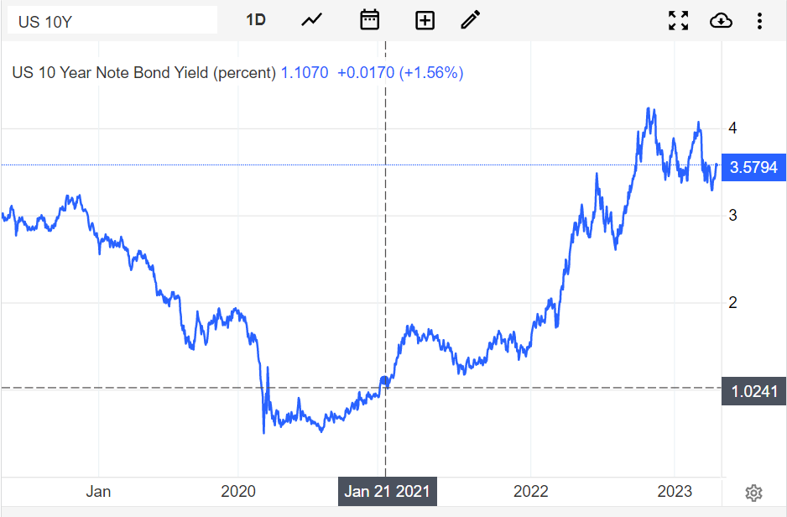
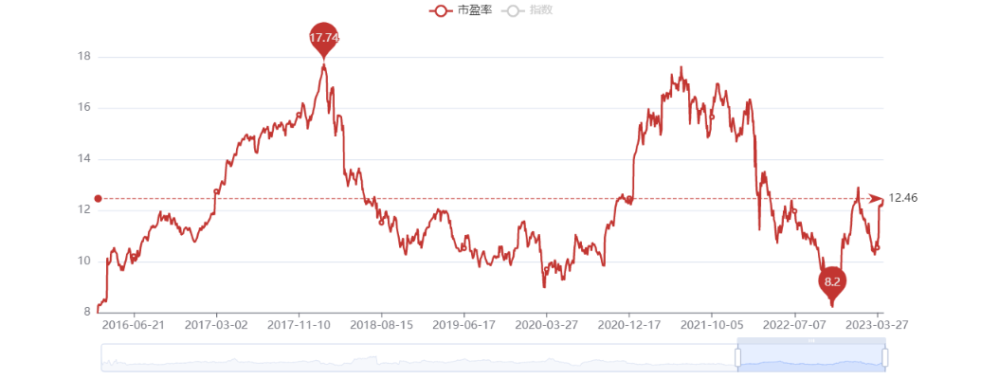
Key Assumptions
Company Profile
Industry Analysis
Business Analysis
Revenue Forecast
Firm Valuation
Cost of debt ratio: US 10-year treasury bond yield
Risk premium: 1/Hang Seng Index(恒生指数)TTM PE
Effective tax rate: 15% (market expectation on Kwai)
Capital structure: Fully financed through equity
Growth rate: perpetually grow at rate 3%
Stable environment - for a relatively reliable β and debt ratio
Trend of Hang Seng Index TTM PE Ratio
Trend of US 10-YEAR treasury Bond Yield
Notes:
Also, we need some basic assumptions before valuation. First is the cost of debt, we use a US 10 year treasury bond because its IPO is based overseas. As for risk premium, we use Hang Seng Index PE. Effective tax rate we set it to 15%. And since this company has no debt, it is fully financed through equity. For growth rate, we assume the company perpetually grow at 3%. Also we expect a stable market to ensure the stability of beta and debt ratio.

Slide 21
DCF Valuation - Absolute Valuation
Company Profile
Industry Analysis
Business Analysis
Revenue Forecast
Firm Valuation
1
2
WACC Valuation
Valuation by DCF
WACC Valuation
Risk-free rate | 1.02%
Risk premium | 8.32%
β | 1.00
Cost of equity | 9.34%
Cost of debt before tax | 1.02%
Tax rate | 15.0%
Cost of debt after tax | 0.87%
WACC | 9.34%
Free cashflow forecast（RMB） | 2021E | 2022E | 2023E | 2024E | 2025E | 2026E
Revenue | 81081.5 | 95766.1 | 121777.7 | 142822.7 | 162675.3 | 184967.7
Revenue growth | 38% | 18% | 27% | 17% | 14% | 14%
EBIT | -28681.7 | -13318.1 | -3541.1 | 8092.2 | 22522.5 | 40414.7
EBIT margin | -35% | -14% | -3% | 6% | 14% | 22%
Tax rate | 1% | 10% | 13% | 13% | 13% | 13%
EBIT* (1-Tax) | -29053.4 | -14649.9 | -4001.4 | 9144.2 | 25450.4 | 45668.6
Depreciation & Amortization | 6246 | 5940.7 | 7432.5 | 8574.2 | 9603.3 | 10734.4
- Changes in working capital | 11057.0 | -751.9 | 6031.1 | 4545.5 | 2329.0 | 4021.6
- Capex | -12211.6 | -3182.8 | -8544.1 | -9716.3 | -9724.8 | -10378.9
Unlevered free cash flow | -23962.0 | -12643.8 | 918.2 | 12547.6 | 27657.9 | 50045.7
Discount Factor | 0.91 | 0.82 | 0.75 | 0.68 | 0.61 | 0.56
Time Factor | 1 | 2 | 3 | 4 | 5 | 6
2
3
DCF Analysis
4
Sensitivity Analysis
NPV of FCF | ￥54,854.2
Terminal value | ￥813.420.9
PV of terminal value | ￥584,408.5
Enterprise Value | ￥639,262.7
Net Cash/(Debt), Minority interests | ￥32612.42
Equity Value (RMB mn) | ￥671,868.5
Total Shares (mn) | 4304.6
Per Share Value (CNY) | ￥156.08
Key Assumption : Perpetual Growth =3%; WACC=9.3%
Perpetual Growth |  | 2.70% | 2.80% | 2.90% | 3.00% | 3.10% | 3.20% | 3.30% | 3.40%
WACC | 7.80% | 198.34 | 202.06 | 205.93 | 209.97 | 214.17 | 218.56 | 223.15 | 227.94
 | 8.30% | 179.52 | 182.56 | 185.71 | 188.99 | 192.39 | 195.92 | 199.60 | 203.42
 | 8.80% | 163.80 | 166.32 | 168.94 | 171.64 | 174.44 | 177.34 | 180.35 | 183.46
 | 9.30% | 150.47 | 152.61 | 154.80 | 157.07 | 159.41 | 161.83 | 164.32 | 166.91
 | 9.80% | 139.04 | 140.86 | 142.73 | 144.65 | 146.64 | 148.68 | 150.78 | 152.95
 | 10.30% | 129.13 | 130.70 | 132.30 | 133.95 | 135.65 | 137.40 | 139.19 | 141.04
 | 10.80% | 120.46 | 121.82 | 123.21 | 124.64 | 126.11 | 127.61 | 129.16 | 130.75
Source: Kwai prospectus, Company filings, Wind, Choice
Notes:
Here is the Discount cash flow valuation result. According to previous information, we first give a valuation of WACC, and here we get the result of 9.34%. Also, based on revenue forecast my teammates has given, we use the formula to calculate those figures. And we get NPV of the free cash flow, from 2021 to 2026. Using the capital structure, we finally get the DCF result as 156 per share.
On the bottom right side gives the sensitivity analysis. We can see that the reasonable range of stock price lies in 130.7 to 195.9. Compared to the issue price 115, we can see that kuaishou is actually undervalued. At the same time, as an Internet company, Kuaishou has a very high room for growth. Especially when the bond rate is very low, we have strong evidence to suggest that investors will have positive attitude to this company.

